Slide 1

Recurrent Neural Networks (RNN)

Slide 2
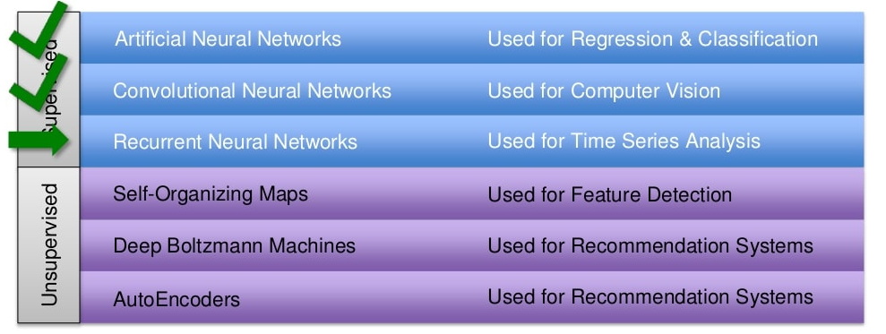
So far what we have done

Slide 3
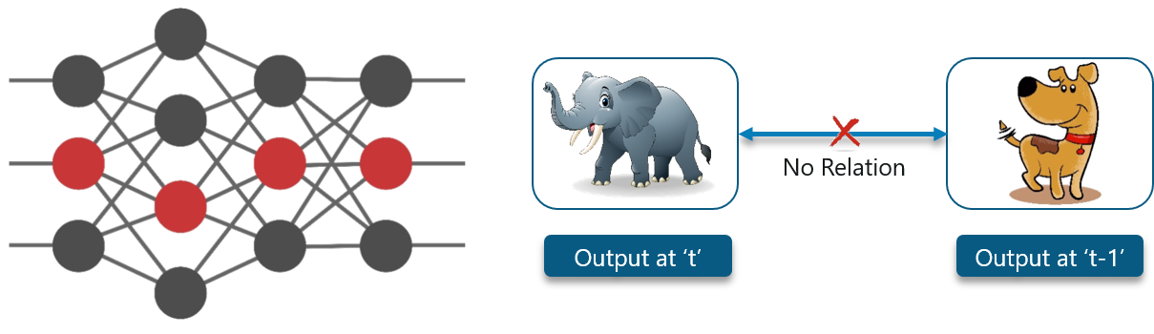
Scenario 1
Consider an image classification use-case where you have trained the neural network to classify images of various animals.
Consider the following diagram:

Slide 4
Explanation
Here, the first output being an elephant will have no influence of the previous output which was a dog.
This means that output at time ‘t’ is independent of output at time ‘t-1’.

Slide 5
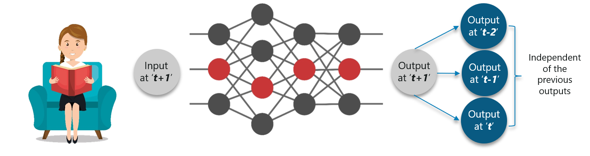
Scenario 2
Consider this scenario where you will require the use of the previously obtained output:

Slide 6
Explanation
The concept is similar to reading a book.
With every page you move forward into, you need the understanding of the previous pages to make complete sense of the information ahead in most of the cases.
With a feed-forward network the new output at time ‘t+1’ has no relation with outputs at either time t, t-1 or t-2.
So, feed-forward networks cannot be used when predicting a word in a sentence as it will have no absolute relation with the previous set of words.
But, with Recurrent Neural Networks, this challenge can be overcome.

Slide 7
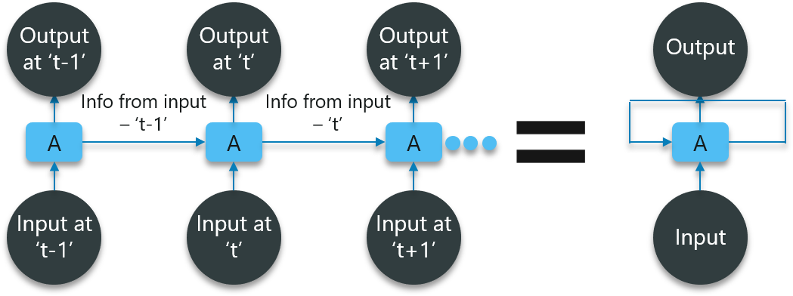
Consider the following diagram:

Slide 8
Explanation
In the diagram, we have certain inputs at ‘t-1’ which is fed into the network. These inputs will lead to corresponding outputs at time ‘t-1’ as well.
At the next timestamp, information from the previous input ‘t-1’ is provided along with the input at ‘t’ to eventually provide the output at ‘t’ as well.
This process repeats, to ensure that the latest inputs are aware and can use the information from the previous timestamp is obtained.

Slide 9
What Are Recurrent Neural Networks?
Recurrent Networks are a type of artificial neural network designed to recognize patterns in sequences of data.

Slide 10

Activity 1
Why we are studying this topic?

Slide 11

Scenario 3
You go to the gym regularly and the trainer has given you the following schedule for your workout:

Slide 12
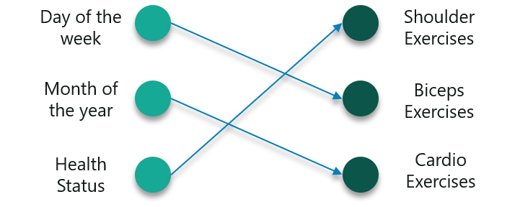
Solution 1
Note that all these exercises are repeated in a proper order every week. First, let us use a feed-forward network to try and predict the type of exercise.

Slide 13

Output
However, this will not be very accurate considering the input.

Slide 14
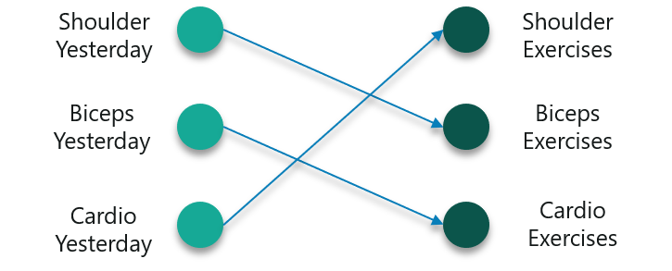
May be the solution is…
To fix this, we can make use of the concept of Recurrent Neural Networks as shown below:
So if you did a shoulder workout yesterday, you can do a bicep exercise today and this goes on for the rest of the week as well.

Slide 15
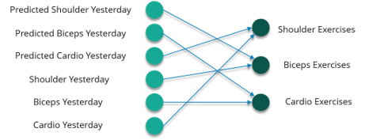
The better one..
However, if you happen to miss a day at the gym, the data from the previously attended timestamp can be considered as shown below:
If a model is trained based on the data it can obtain from the previous exercises, the output from the model will be extremely accurate.

Slide 16
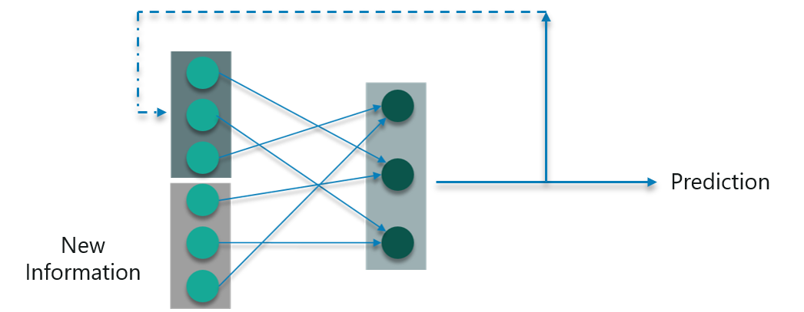
Convert to Vectors
Vectors are numbers which are input to the model to denote if you have done the exercise or not.
So, if you have a shoulder exercise, the corresponding node will be ‘1’ and the rest of the exercise nodes will be mapped to ‘0’.

Slide 17
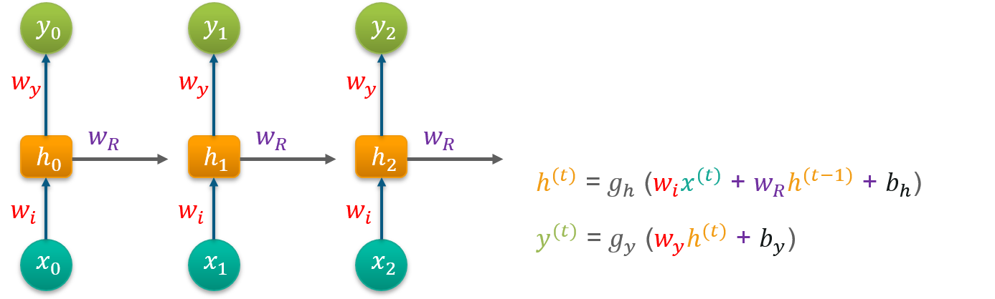
Mathematics behind this
Consider ‘w’ to be the weight matrix and ‘b’ being the bias:
At time t=0, input is ‘x0’ and the task is to figure out what is ‘h0’. Substituting t=0 in the equation and obtaining the function h(t) value. Next, the value of ‘y0’ is found out using the previously calculated values when applied to the new formula.
This process is repeated through all of the timestamps in the model to train a model.

Slide 18
Training Recurrent Neural Networks
Recurrent Neural Networks use backpropagation algorithm for training, but it is applied for every timestamp. It is commonly known as Back-propagation Through Time (BTT).
There are some issues with Back-propagation such as:
Vanishing Gradient
Exploding Gradient

Slide 19
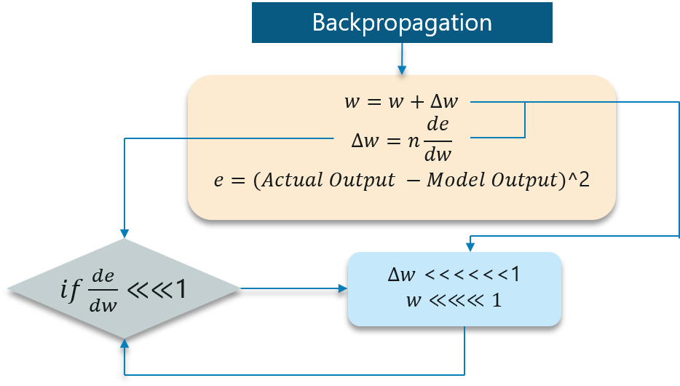
Vanishing Gradient
When making use of back propagation the goal is to calculate the error which is actually found out by finding out the difference between the actual output and the model output and raising that to a power of 2.

Slide 20
Explanation
With the error calculated, the changes in the error with respect to the change in the weight is calculated. But with each learning rate, this has to be multiplied with the same.
So, the product of the learning rate with the change leads to the value which is the actual change in the weight.
This change in weight is added to the old set of weights for every training iteration as shown in the figure. The issue here is when the change in weight is multiplied, the value is very less.
Consider you are predicting a sentence say,“I am going to France” and you want to predict “I am going to France, the language spoken there is _____”
A lot of iterations will cause the new weights to be extremely negligible and this leads to the weights not being updated.

Slide 21

Exploding Gradient
The working of the exploding gradient is similar but the weights here change drastically instead of negligible change. Notice the small change in the diagram below:

Slide 22
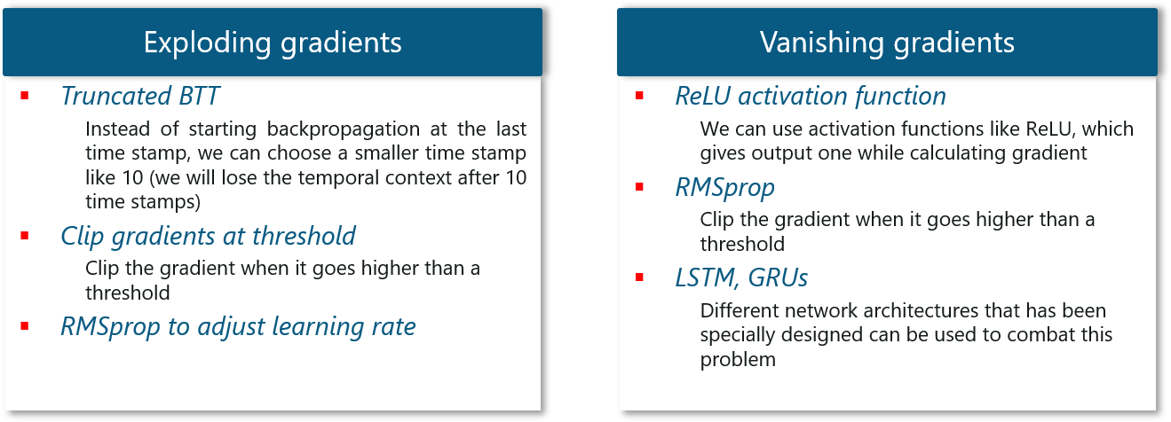
Solutions

Slide 23
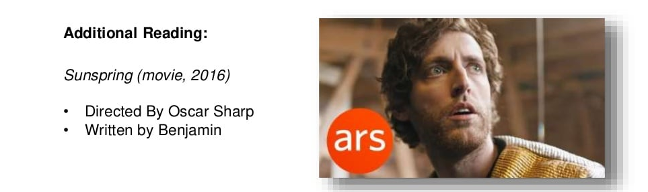
Interesting Fact..
https://arstechnica.com/gaming/2021/05/an-ai-wrote-this-movie-and-its-strangely-moving/

Slide 24
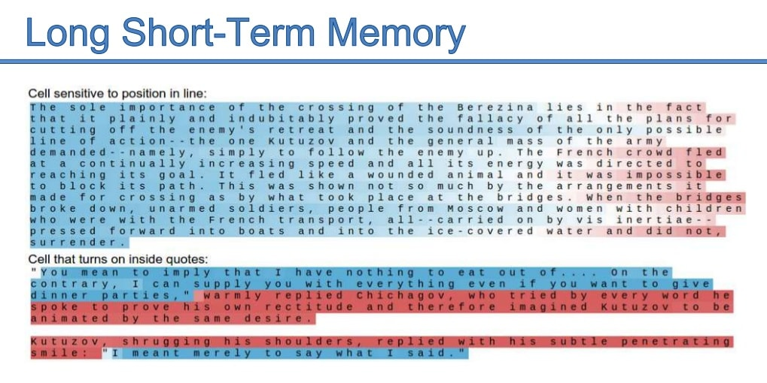

Slide 25
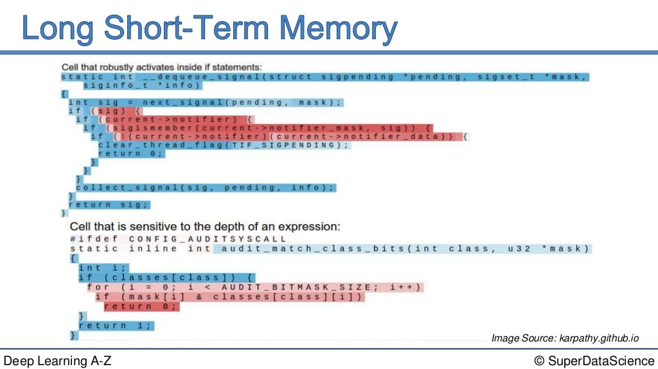

Slide 26
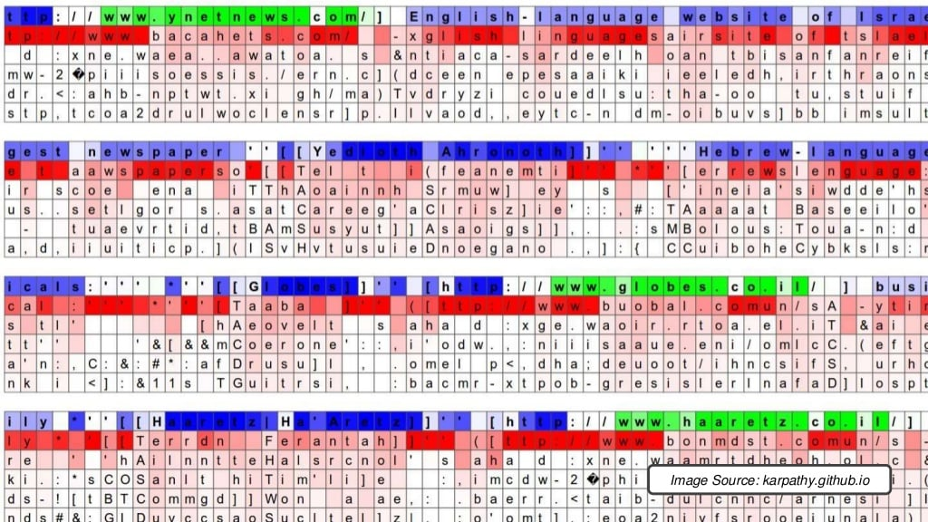

Slide 27
Long Short-Term Memory Networks
Long Short-Term Memory networks are usually just called “LSTMs”.
They are a special kind of Recurrent Neural Networks which are capable of learning long-term dependencies.

Slide 28
What are long-term dependencies?
Many times only recent data is needed in a model to perform operations. But there might be a requirement from a data which was obtained in the past.
Let’s look at the following example:
Consider a language model trying to predict the next word based on the previous ones. If we are trying to predict the last word in the sentence say “The clouds are in the sky”.
The context here was pretty simple and the last word ends up being sky all the time. In such cases, the gap between the past information and the current requirement can be bridged really easily by using Recurrent Neural Networks.
So, problems like Vanishing and Exploding Gradients do not exist and this makes LSTM networks handle long-term dependencies easily.

Slide 29
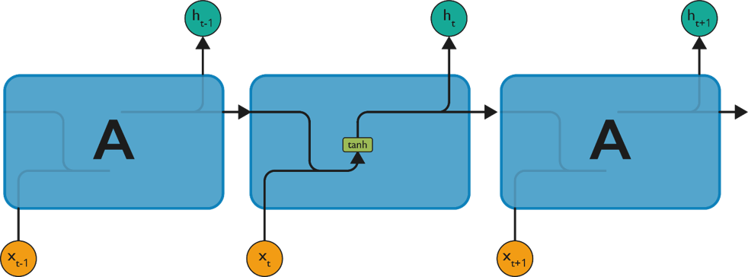
LSTM
LSTM have chain-like neural network layer. In a standard recurrent neural network, the repeating module consists of one single function as shown in the below figure:

Slide 30
Explanation
As shown above, there is a tanh function present in the layer. This function is a squashing function. So, what is a squashing function?
It is a function which is basically used in the range of -1 to +1 and to manipulate the values based on the inputs.

Slide 31
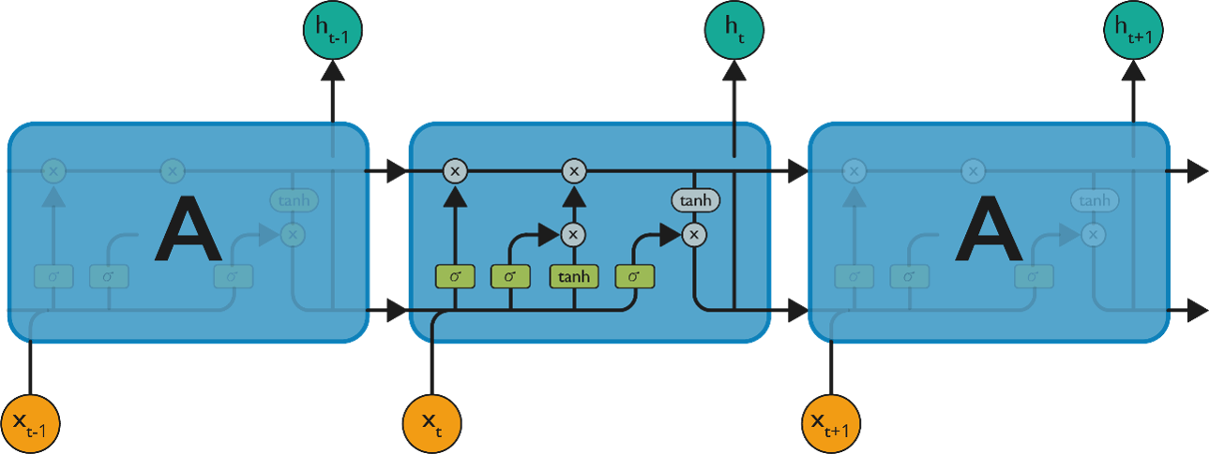
Structure
The cell state is the horizontal line in the figure and it acts like a conveyer belt carrying certain data linearly across the data channel.

Slide 32
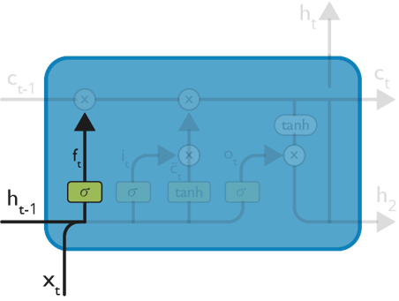
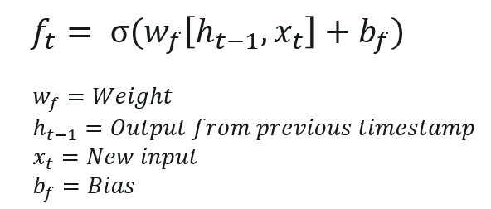
Step 1:
The first step in the LSTM is to identify that information which is not required and will be thrown away from the cell state. This decision is made by a sigmoid layer called as forget gate layer.
The highlighted layer in the above is the sigmoid layer.
The calculation is done by considering the new input and the previous timestamp which eventually leads to the output of a number between 0 and 1 for each number in that cell state.

Slide 33
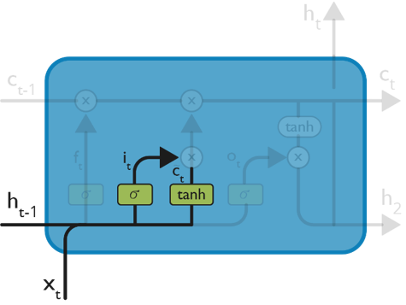
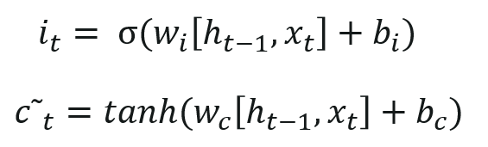
Step 2
The next step is to decide, what new information we’re going to store in the cell state. This whole process comprises of following steps:
A sigmoid layer called the “input gate layer” decides which values will be updated.
The tanh layer creates a vector of new candidate values, that could be added to the state.
The input from the previous timestamp and the new input are passed through a sigmoid function which gives the value i(t). This value is then multiplied by c(t) and then added to the cell state.
In the next step, these two are combined to update the state.

Slide 34
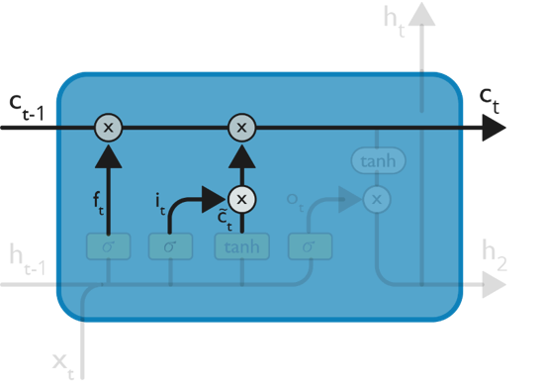

Step 3:
Now, we will update the old cell state Ct−1, into the new cell state Ct.
First, we multiply the old state (Ct−1) by f(t), forgetting the things we decided to leave behind earlier.

Slide 35
Then, we add i_t* c˜_t. This is the new candidate values, scaled by how much we decided to update each state value.
In the second step, we decided to do make use of the data which is only required at that stage.
In the third step, we actually implement it.

Slide 36
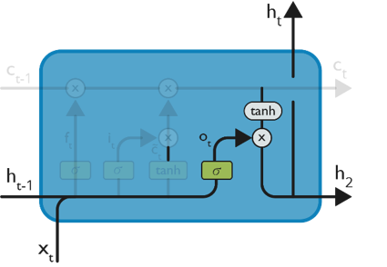
Step 4:
We will run a sigmoid layer which decides what parts of the cell state we’re going to output.
Then, we put the cell state through tanh (push the values to be between −1 and 1)
Later, we multiply it by the output of the sigmoid gate, so that we only output the parts we decided to.

Slide 37
The calculation in this step is pretty much straightforward which eventually leads to the output.
However, the output consists of only the outputs there were decided to be carry forwarded in the previous steps and not all the outputs at once.

Slide 38
Summing up all the 4 steps:
In the first step, we found out what was needed to be dropped.
The second step consisted of what new inputs are added to the network.
The third step was to combine the previously obtained inputs to generate the new cell states.
Lastly, we arrived at the output as per requirement.

Slide 39
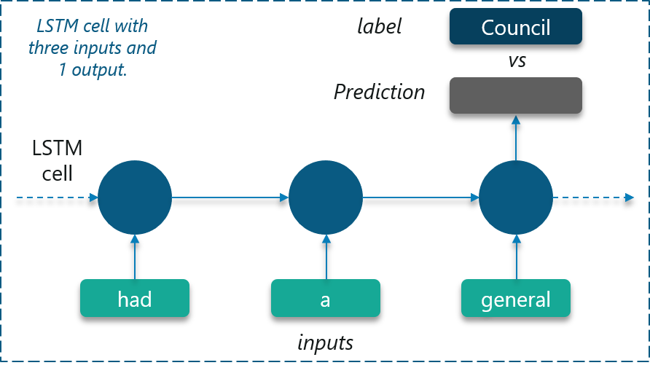
Use Case: Long Short-Term Memory Networks

Slide 40
Explanation
The use case we will be considering is to predict the next word in a sample short story.
We can start by feeding an LSTM Network with correct sequences from the text of 3 symbols as inputs and 1 labeled symbol.
Eventually, the neural network will learn to predict the next symbol correctly!

Slide 41
Dataset:
The LSTM is trained using a sample short story which consists of 112 unique symbols.
Comma and period are also considered as unique symbols in this case.

Slide 42
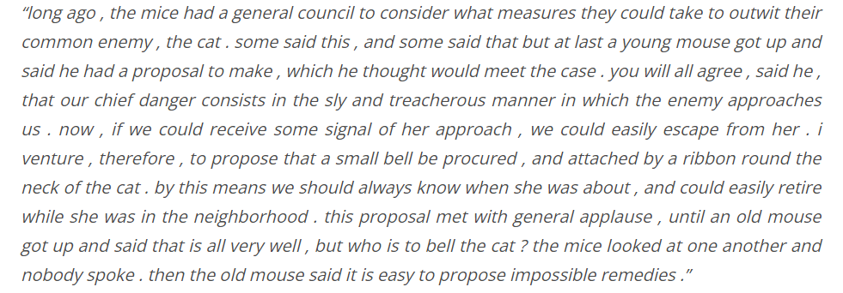

Slide 43
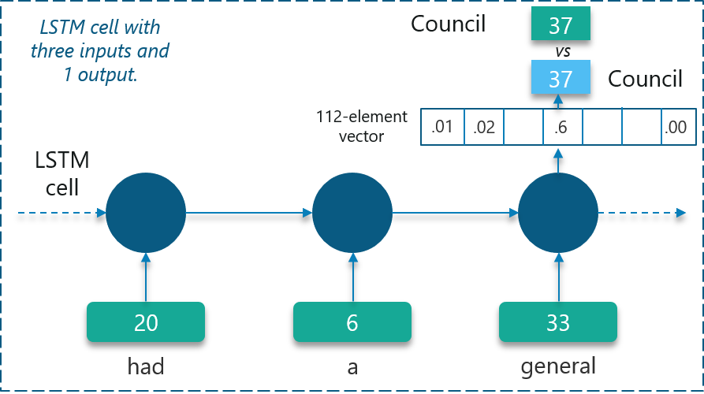
Training:

Slide 44
Explanation
LSTMs can only understand real numbers. So, the first requirement is to convert the unique symbols into unique integer values based on the frequency of occurrence.
Doing this will create a customized dictionary that we can make use of later on to map the values.
Certain symbols are mapped to be integers as shown.
The network will create a 112-element vector consisting of the probability of occurrence of each of these unique integer values.

Slide 45
Implementation (will do later)
Go to https://www.edureka.co/blog/recurrent-neural-networks/
Search Implementation on this page
For understanding the code→ go to the video given below on this page and start playing from 23:00mm till the end.

